Slide 1
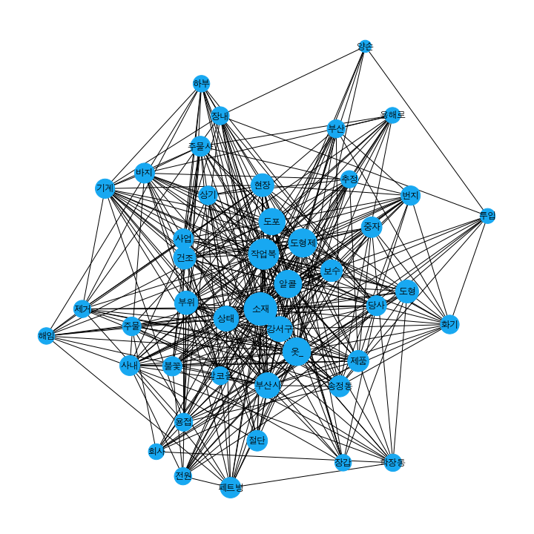
Cluster0
58개 ->54개

Slide 2
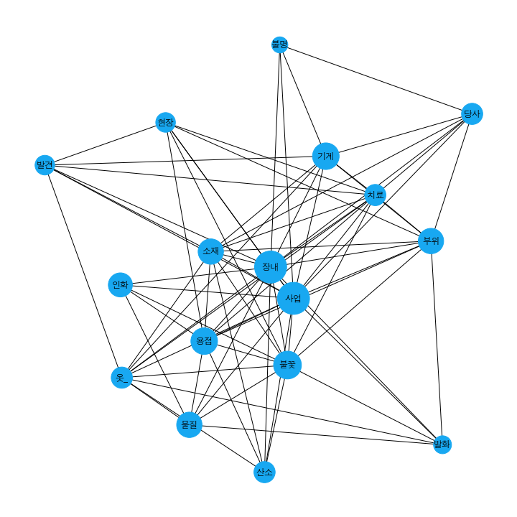
Cluster1
32개 ->29개

Slide 3
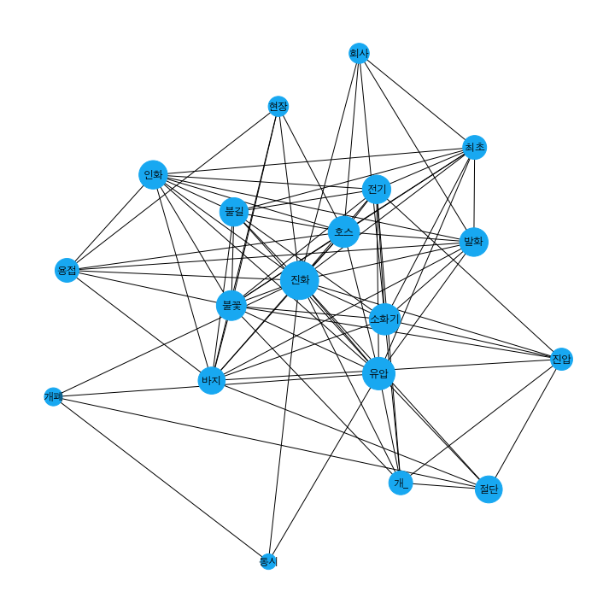
Cluster2
41개 ->37개

Slide 4
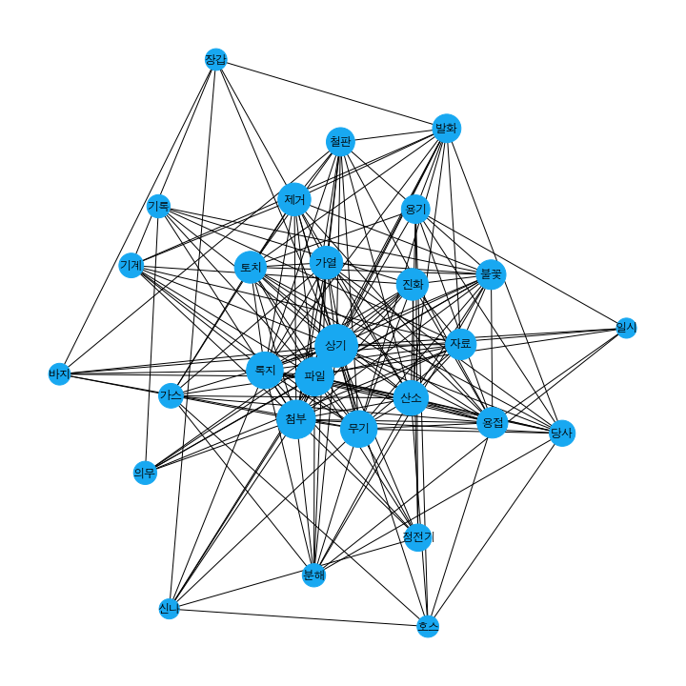
Cluster3
45개 ->36개

Slide 5
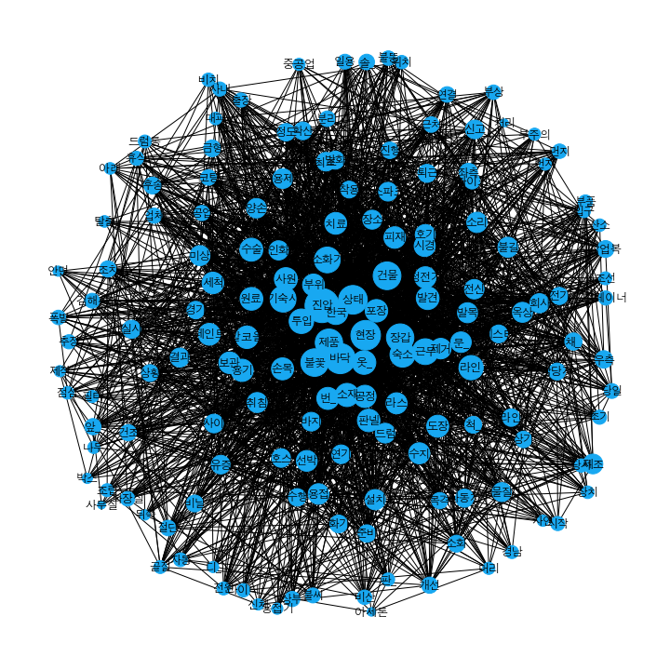
Cluster4
179개 ->167개

Slide 6
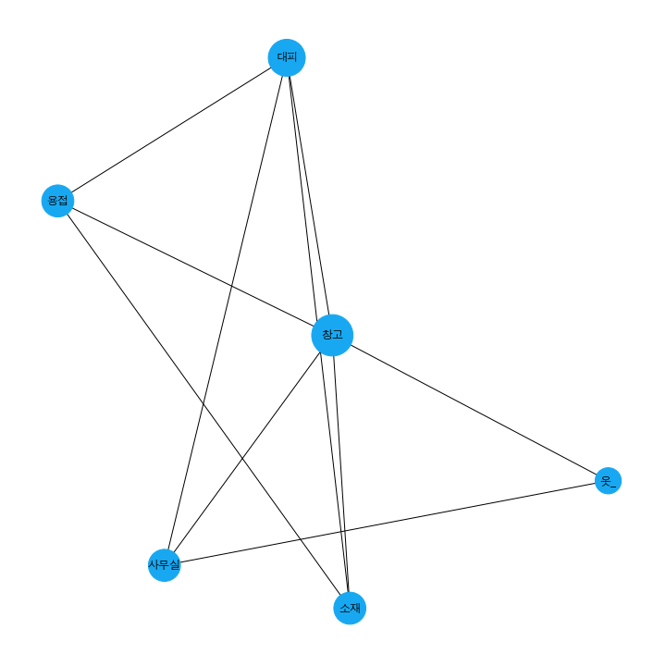
Cluster5
16개 ->14개

Slide 7
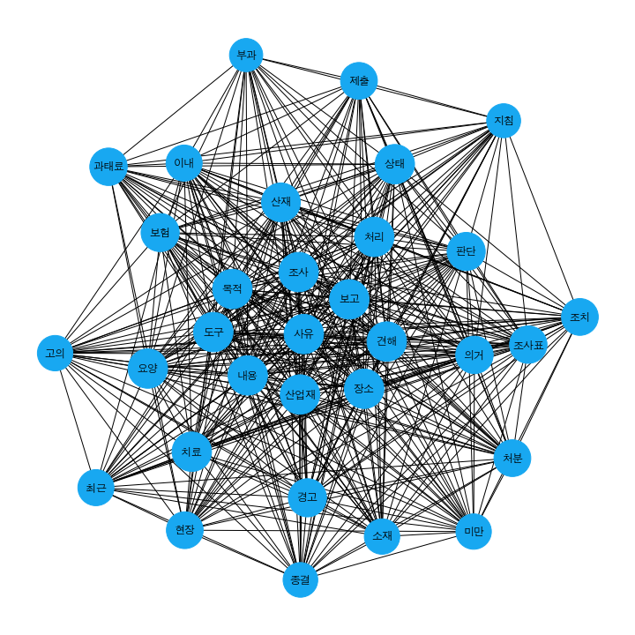
Cluster6
12개 ->12개

Slide 8
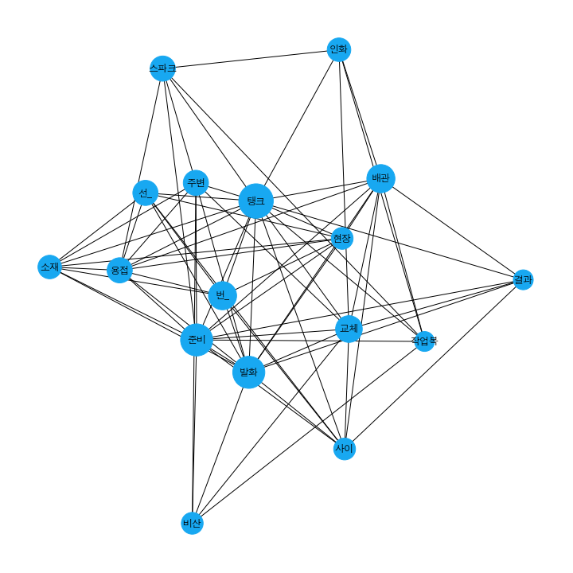
Cluster7
29개 ->22개

Slide 9
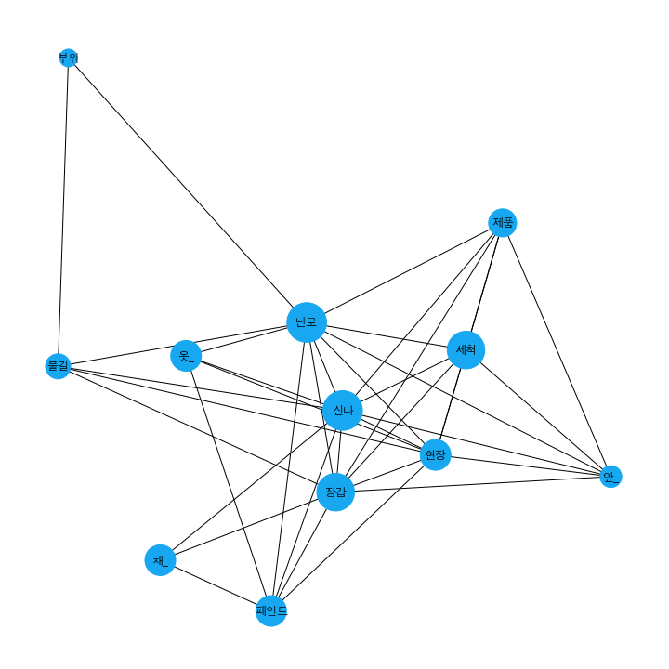
Cluster8
33개 ->33개

Slide 10
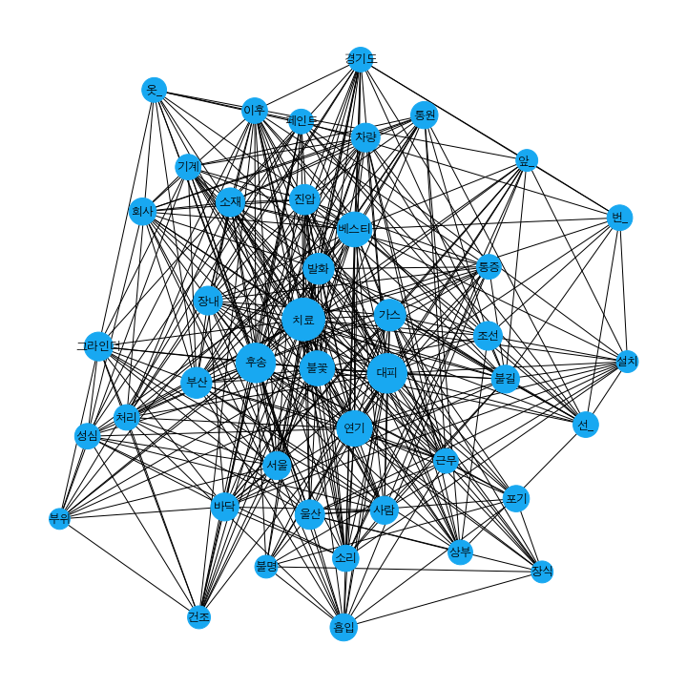
Cluster9
47개 ->41개

Slide 11
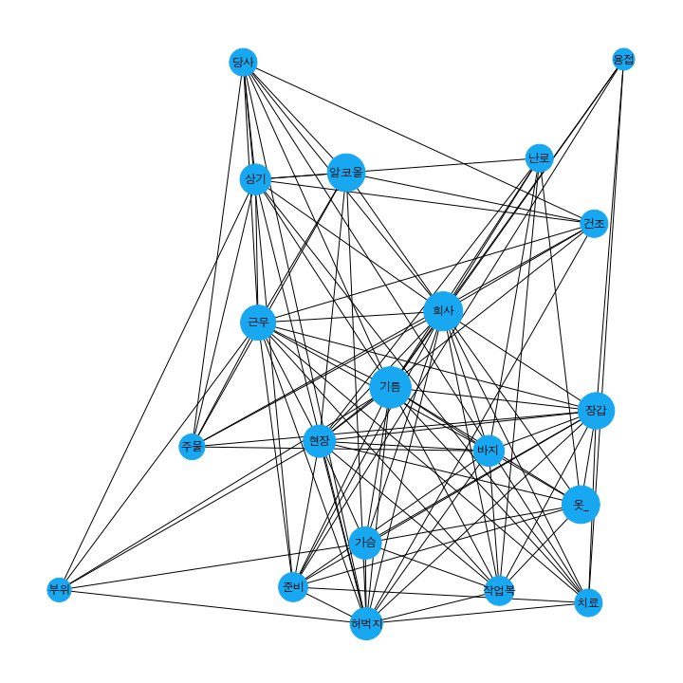
Cluster10
39개 ->39개

Slide 12
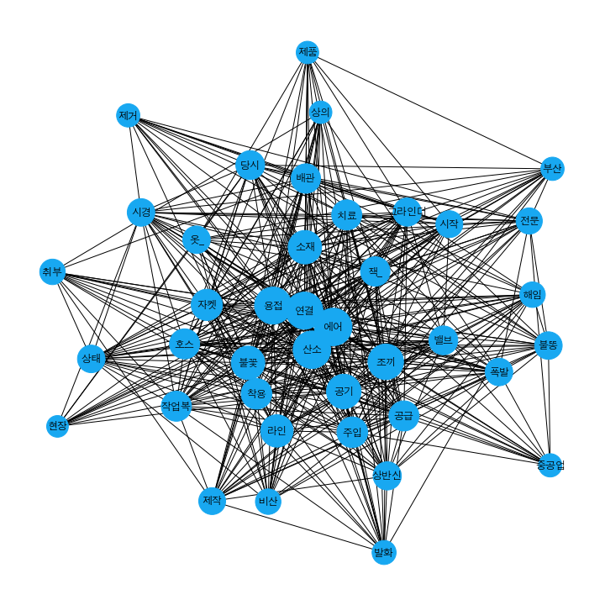
Cluster11
37개 ->34개

Slide 13
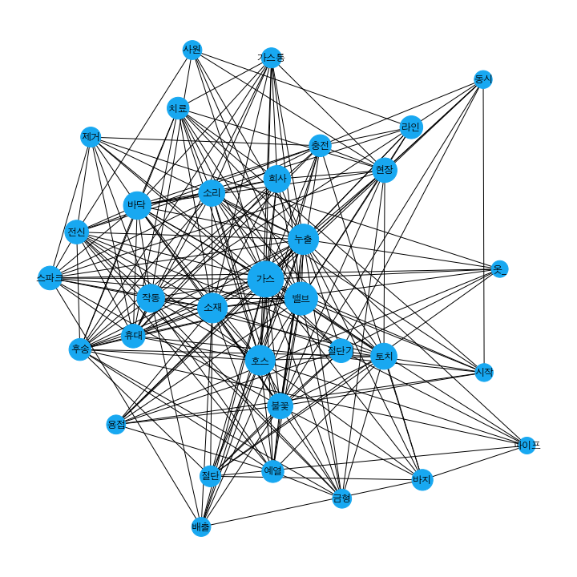
Cluster12
51개 ->49개

Slide 14
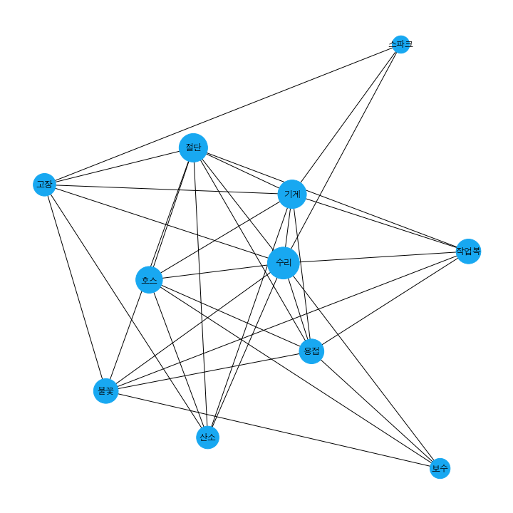
Cluster13
24개 ->24개

Slide 15
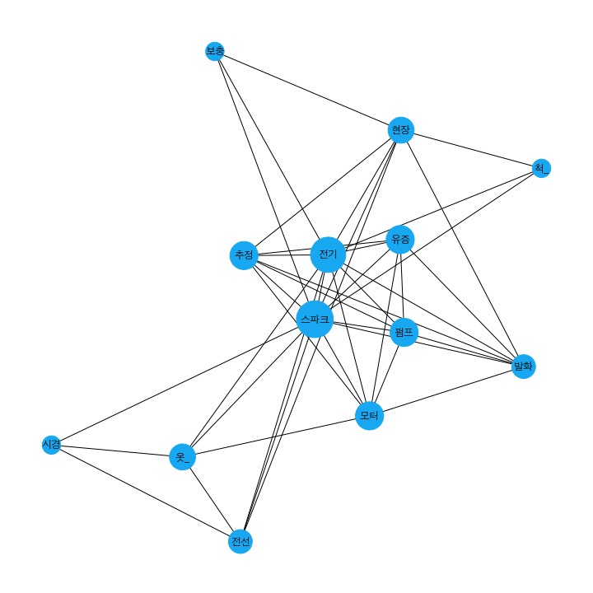
Cluster14
35개 ->30개

Slide 16
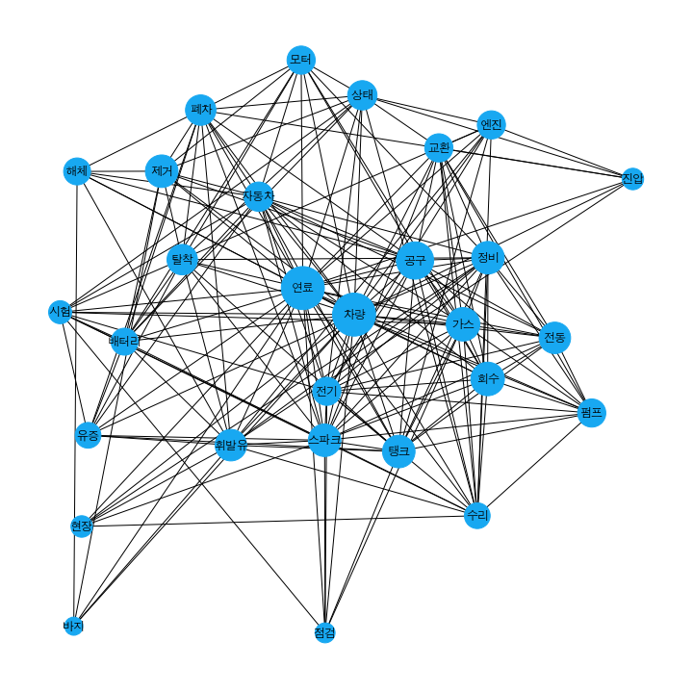
Cluster15
32개 ->32개

Slide 17
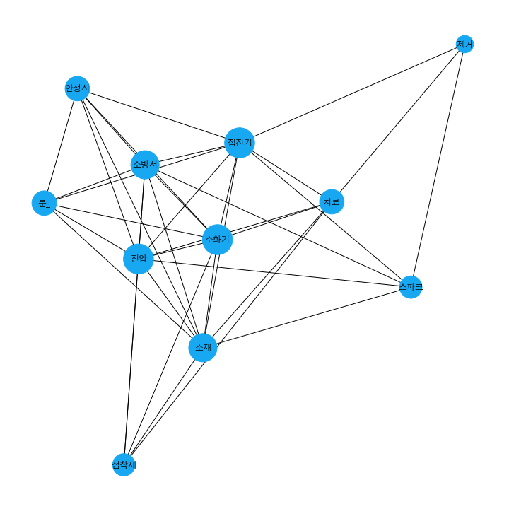
Cluster16
25개 ->17개

Slide 18
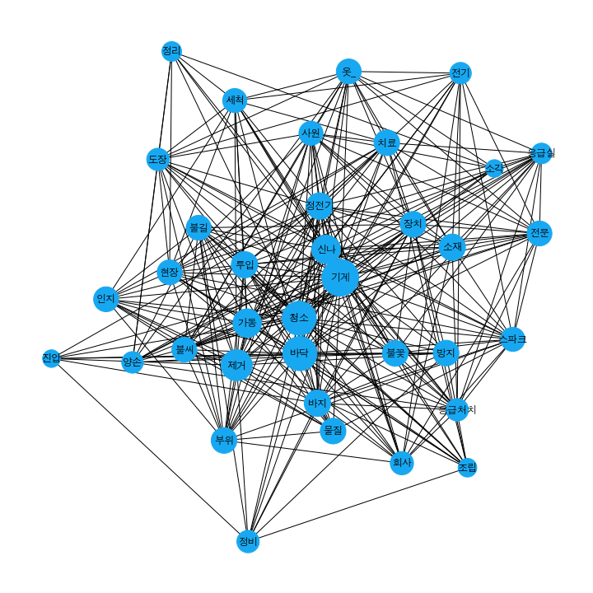
Cluster17
47개 ->41개

Slide 19
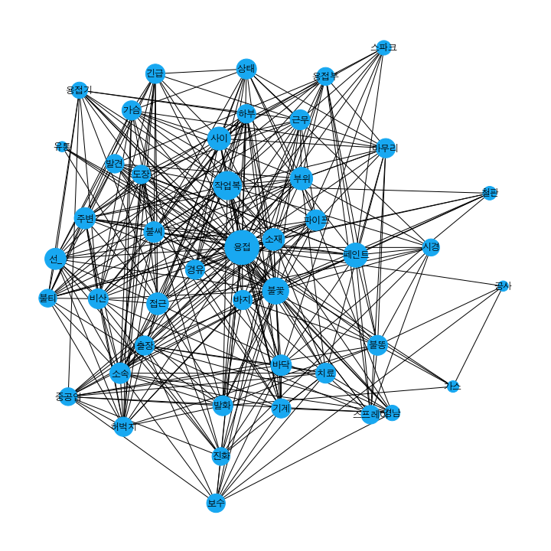
Cluster18
77개 ->55개

Slide 20
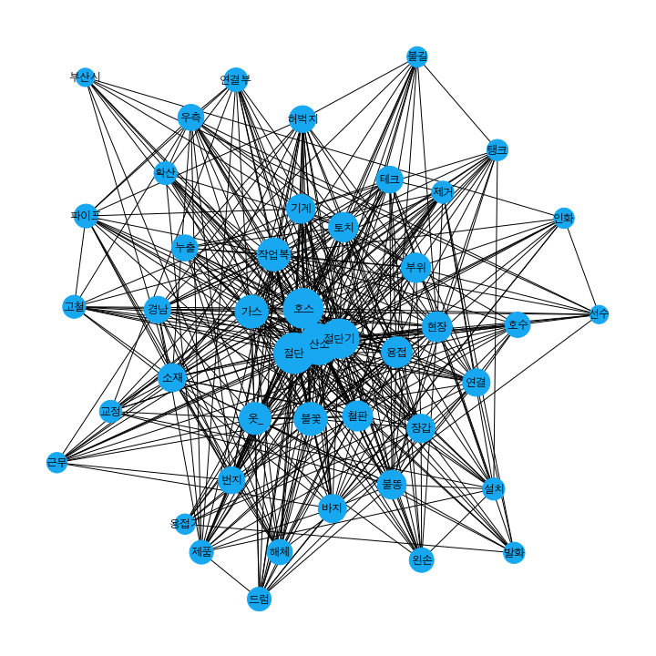
Cluster19
81개 ->79개

